Slide 1
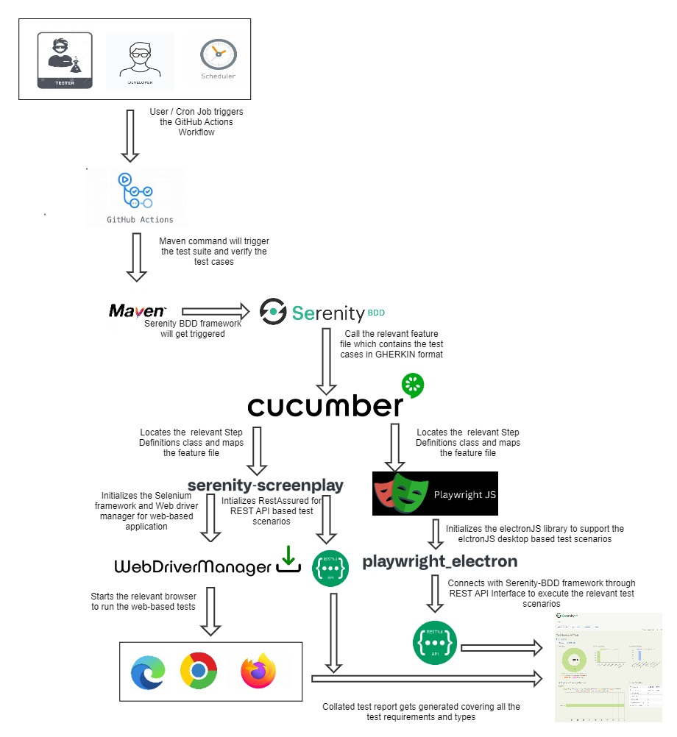
Nupano Test Automation Ecosystem

Slide 2
NUPANO Build Release
Release shifted from MVP (Minimum Viable Product) based to Monthly release
Requirement Engineer initiates this phase
Requirements are finalized and tracked till the release
QA give their approvals based on the quality of the release build
Stakeholders are notified

